Slide 1
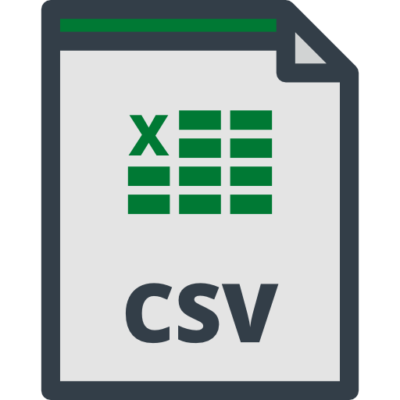


ETL process with
Azure Data Factory

Slide 2
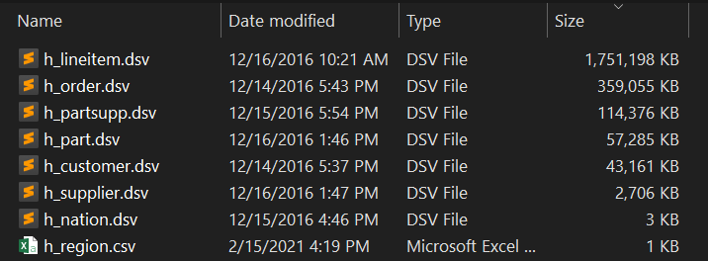
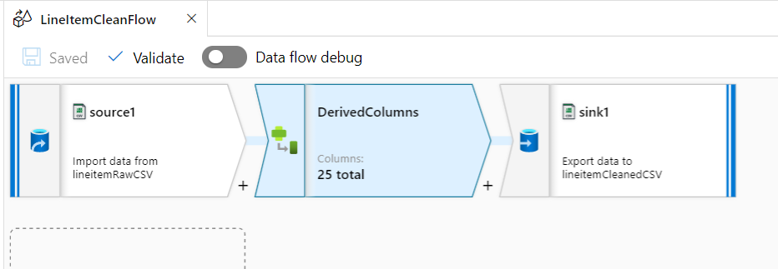
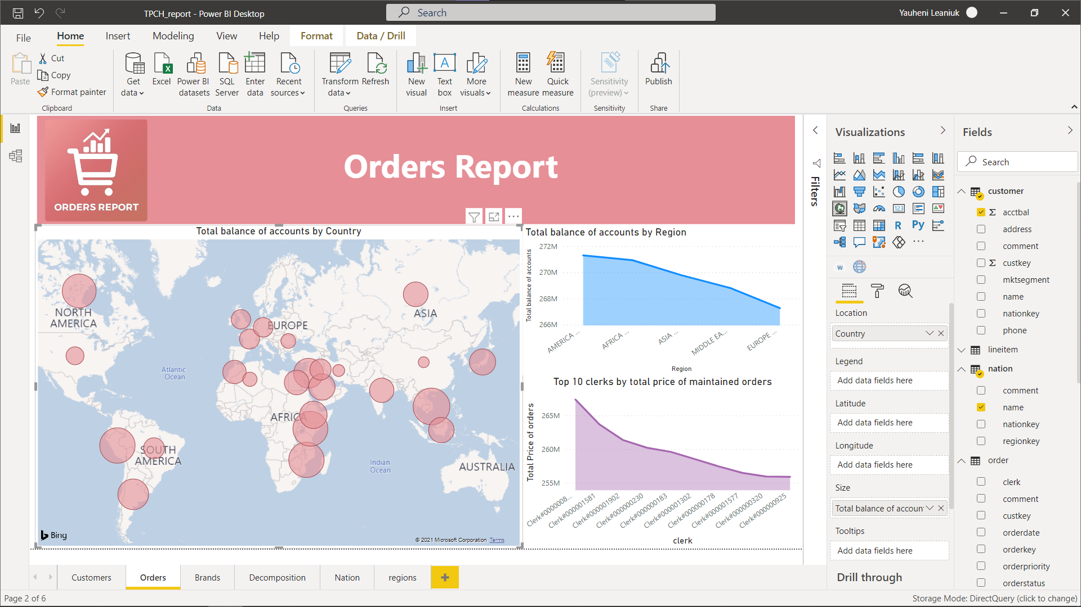
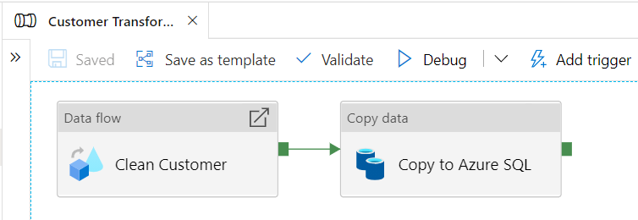
Basic steps of the project
Raw Files (.csv, .dsv)
Transforming to correct datatypes
Connect Azure DB to PowerBI and creating report
Load correct data to Azure SQL DB with pipelines

Slide 3
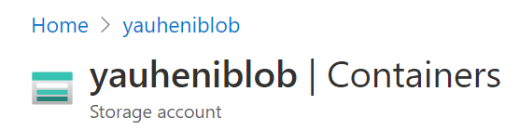
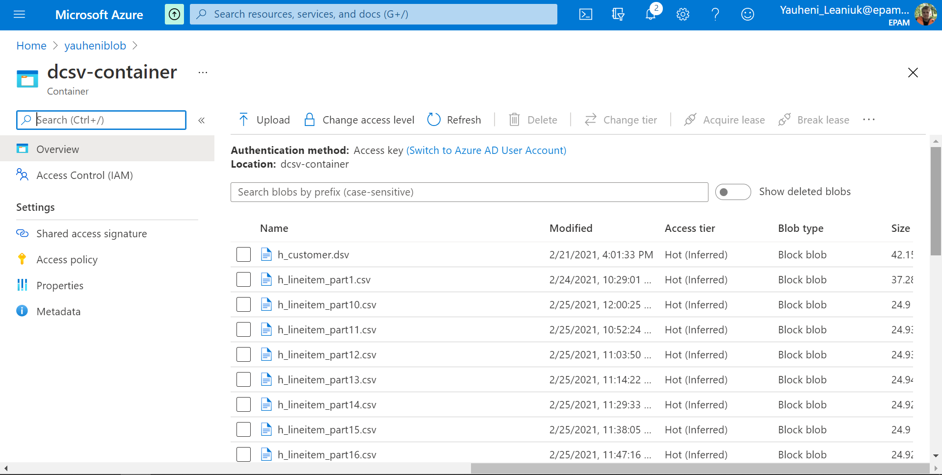
Raw Files
Uploading raw .csv and .dsv files to Azure container “yauheniblob”

Slide 4
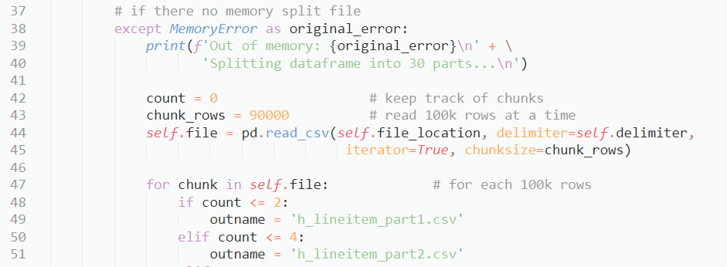
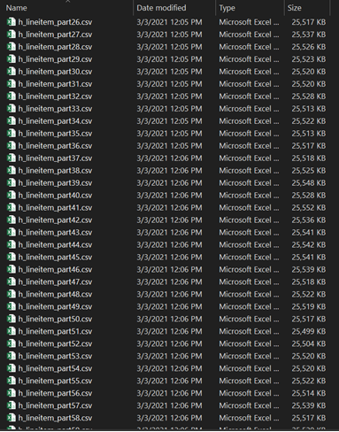

Raw Files
Large file lineitem.dsv splitted into 67 parts with python class DCSV_file_to_MSSQL.py

Slide 5
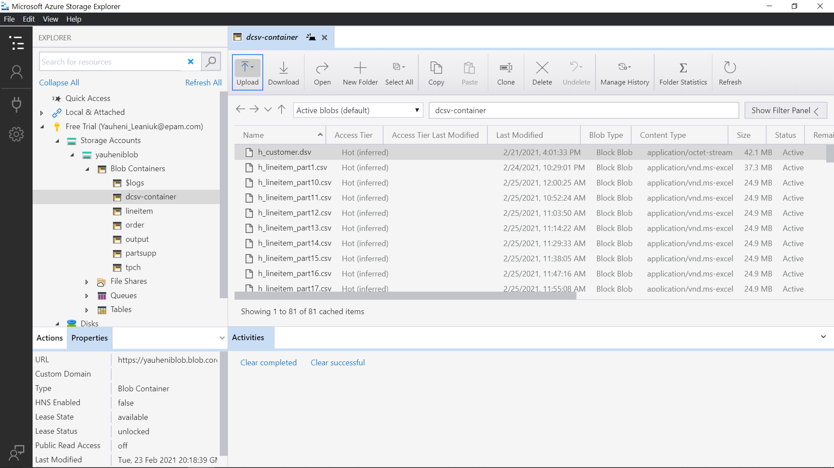
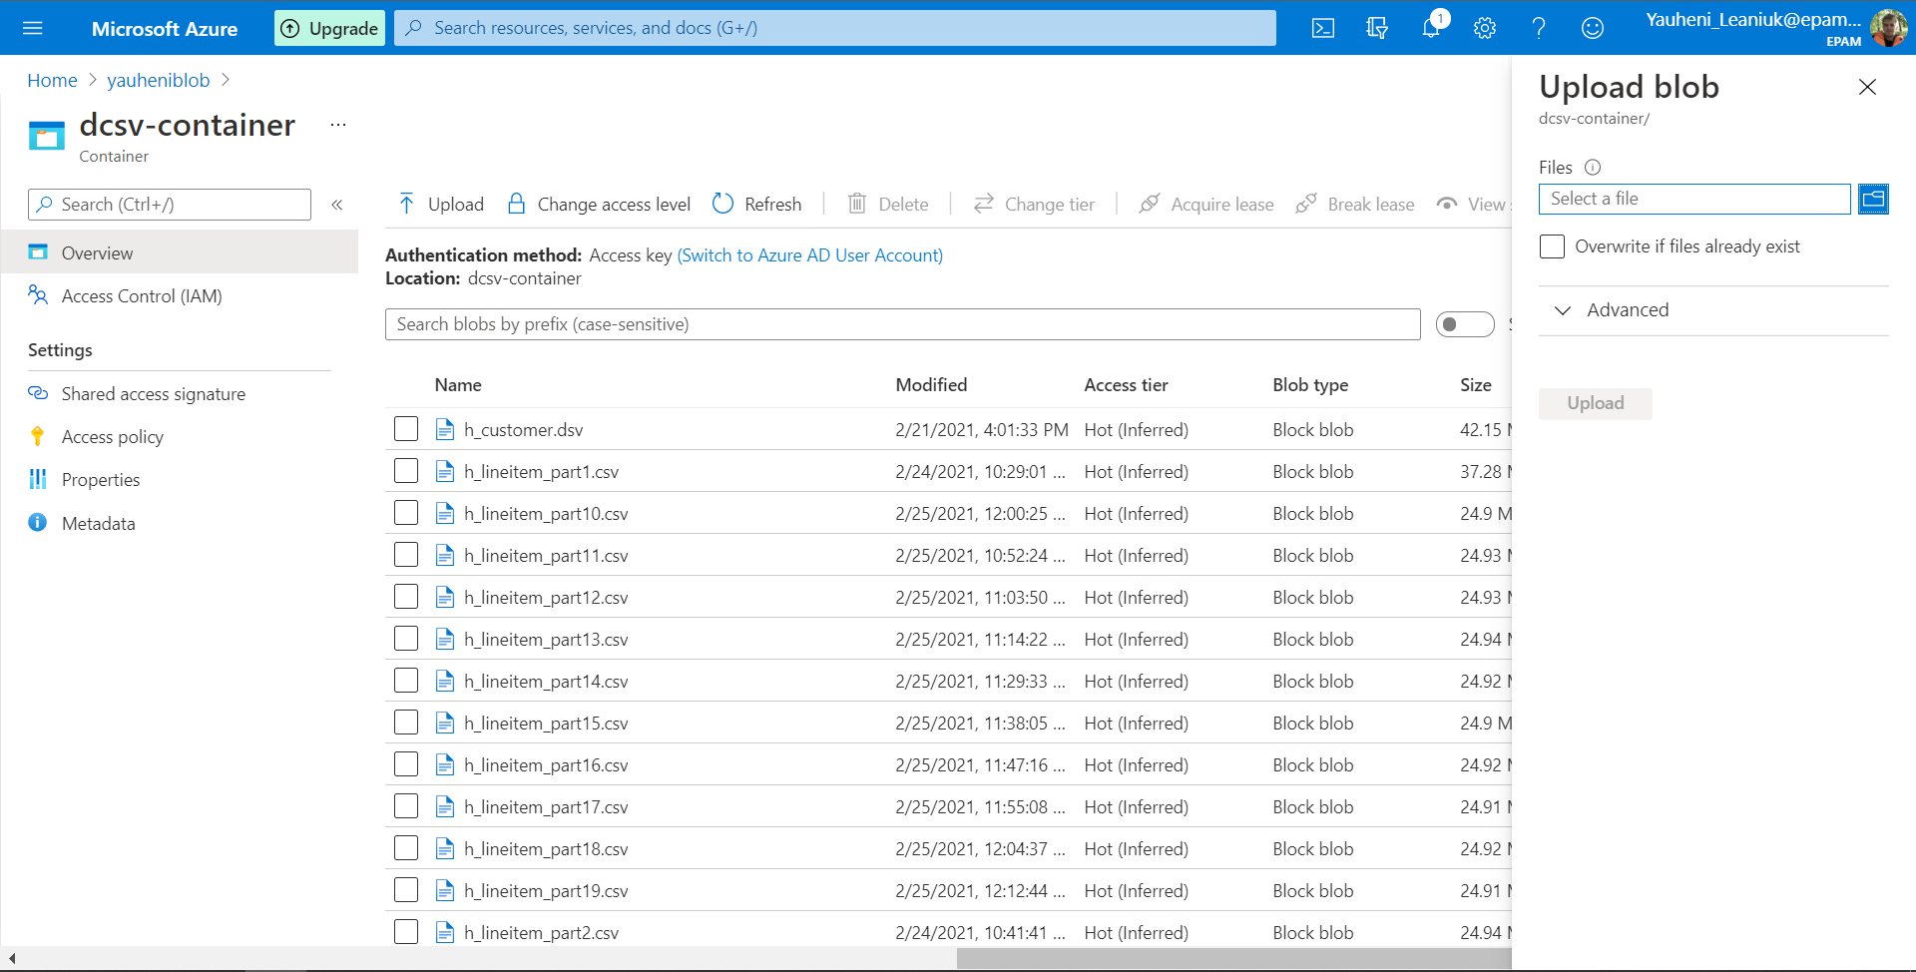
Raw Files
Files uploaded via web version of Azure portal or via StorageExplorer

Slide 6
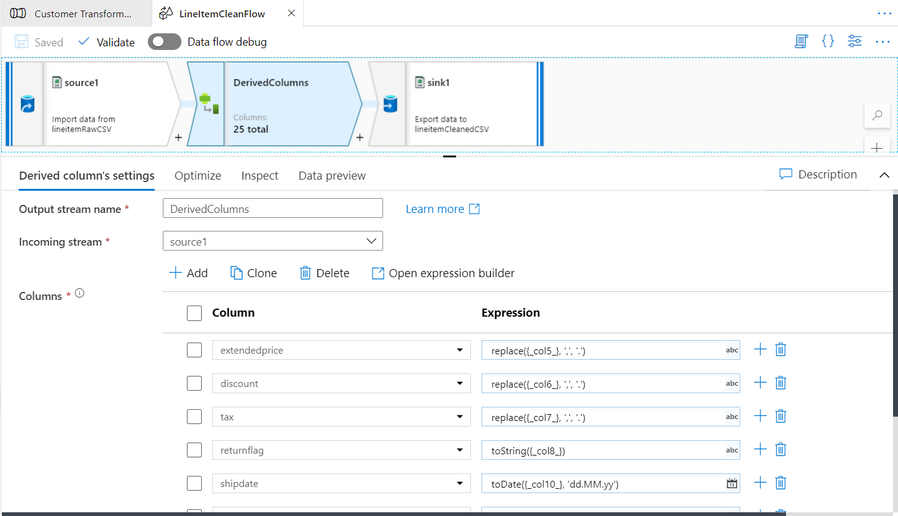
Transform to correct datatypes
Creating Data Flow that creates new columns with correct datatype for every file

Slide 7
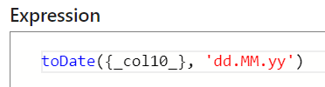

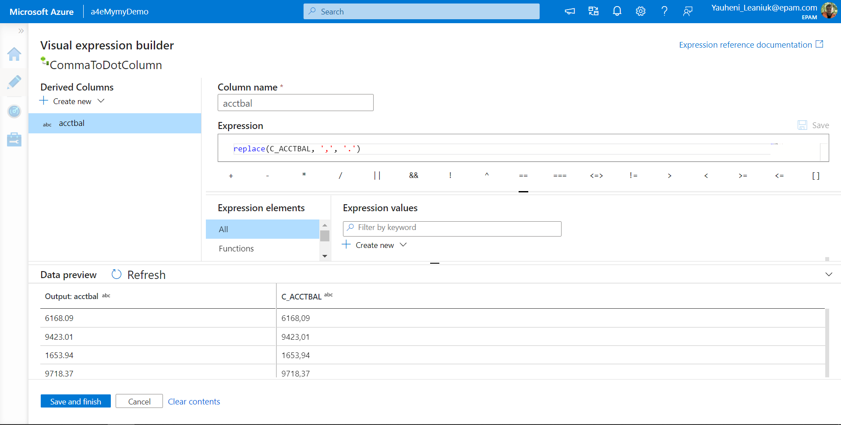
Transform to correct datatypes
Scala functions for derived columns

Slide 8
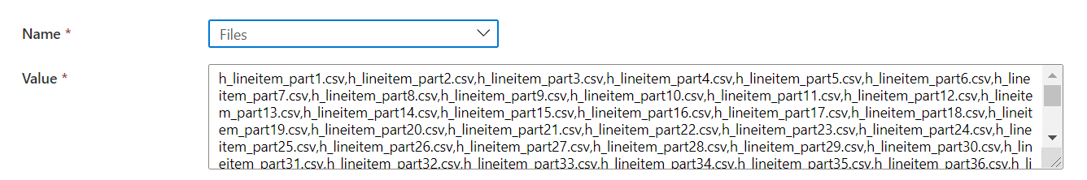
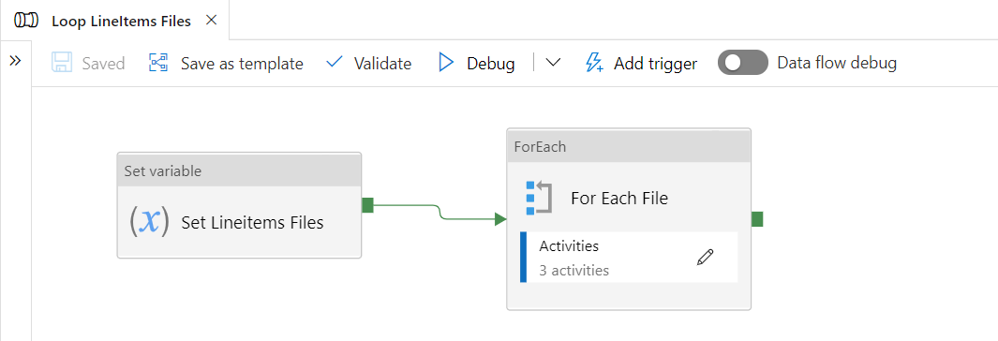
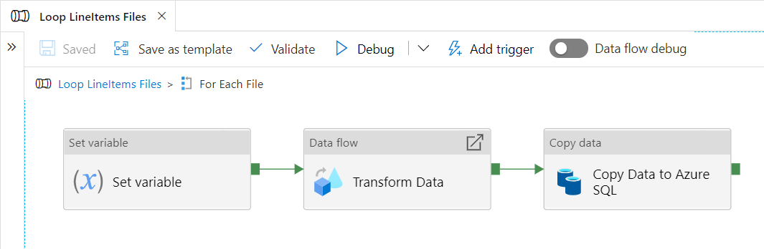
Transform to correct datatypes
For 67 files, For Each Loop created
1. Set variable as array of all files (parts of lineitem)
1. Set variable as array of all files (parts of lineitem)
2. Loop for every file (part of lineitem)
3. Inside Loop setting variable as each
file in array, transforming each file
with new derived columns with correct
datatypes, copying correct data into
Azure SQL database

Slide 9
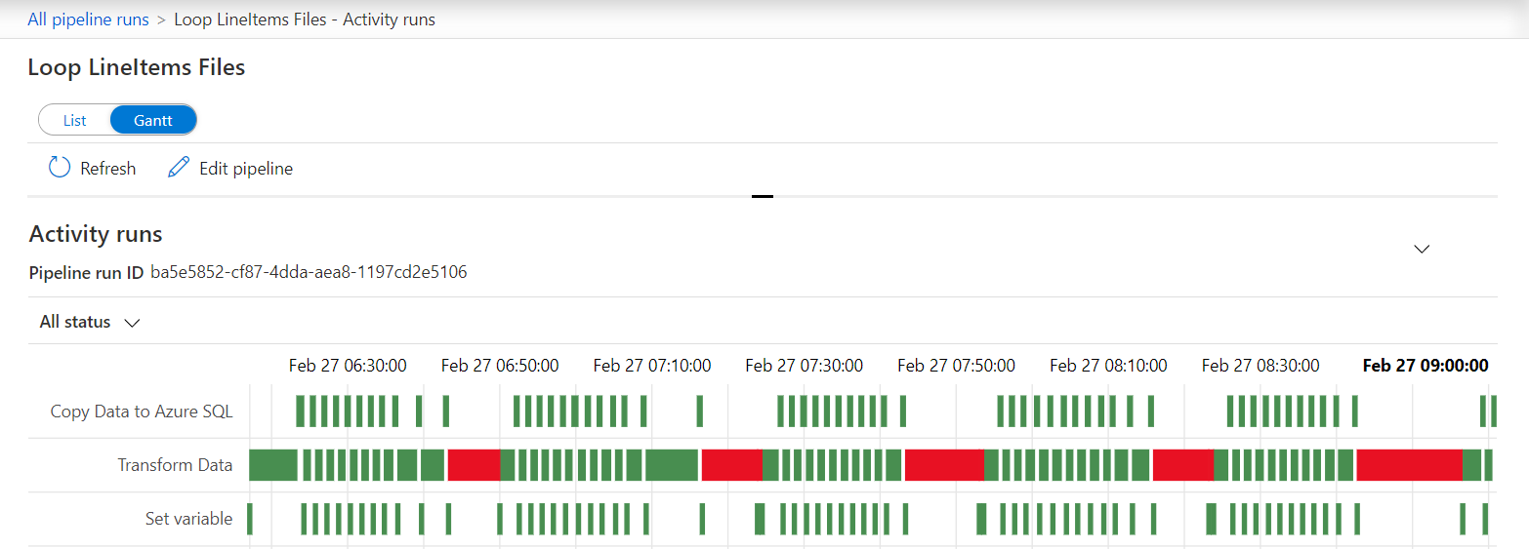
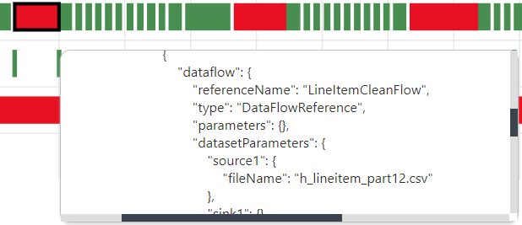
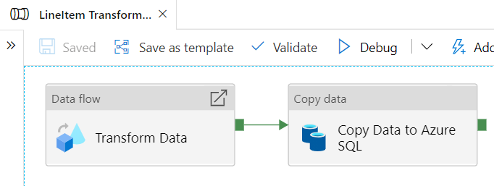

Transform to correct datatypes
6 files catches an error
Send 6 files to pipeline manually

Slide 10
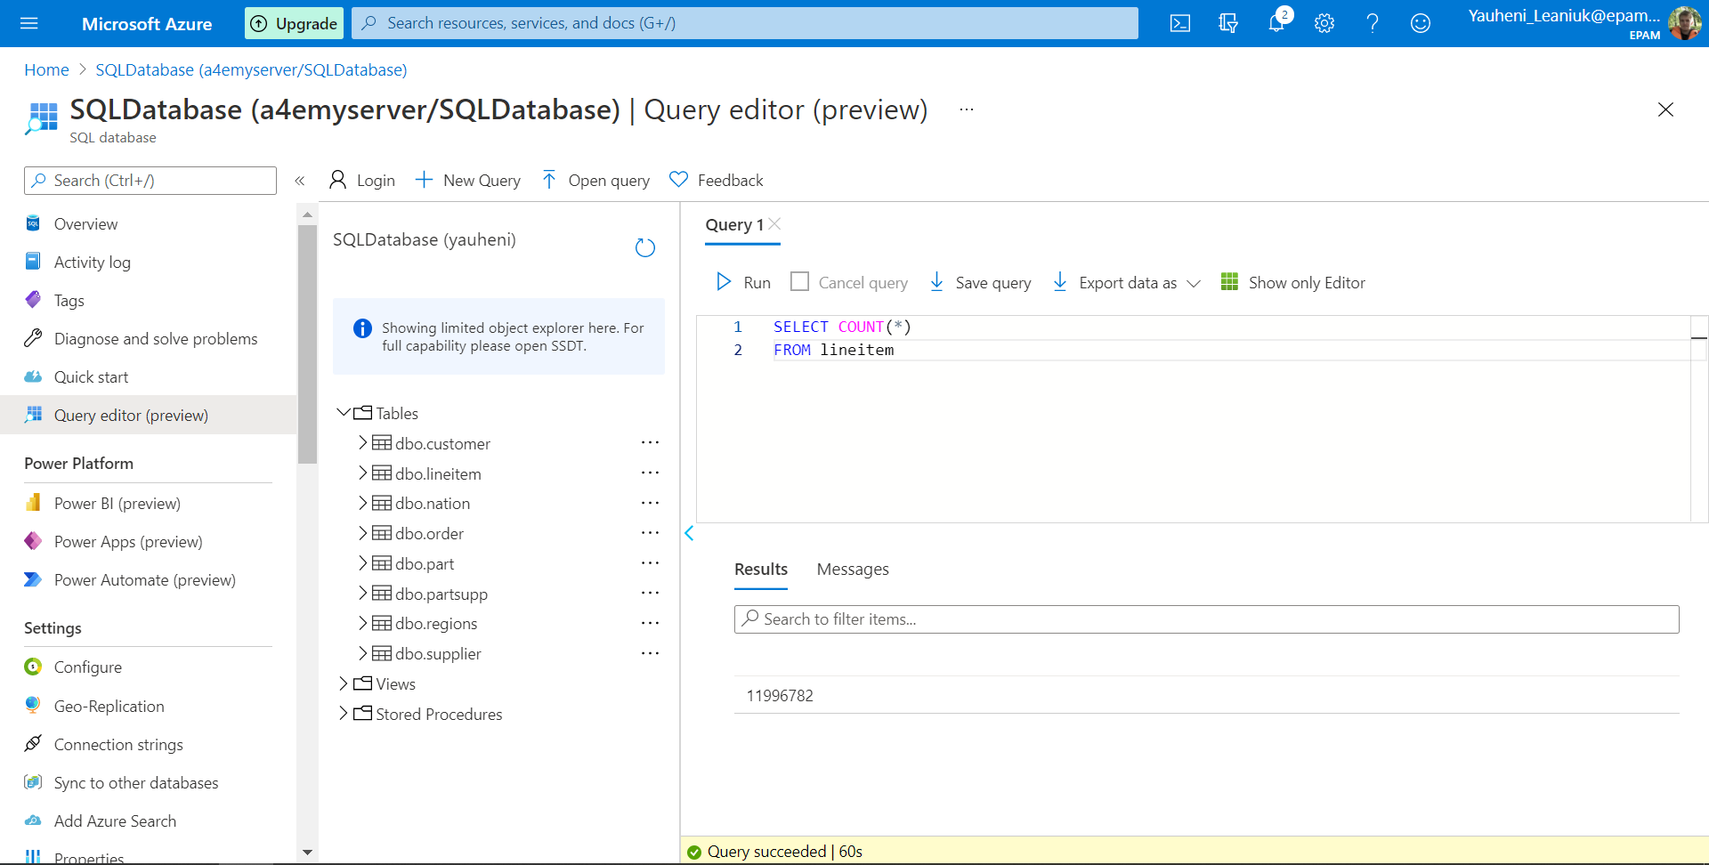
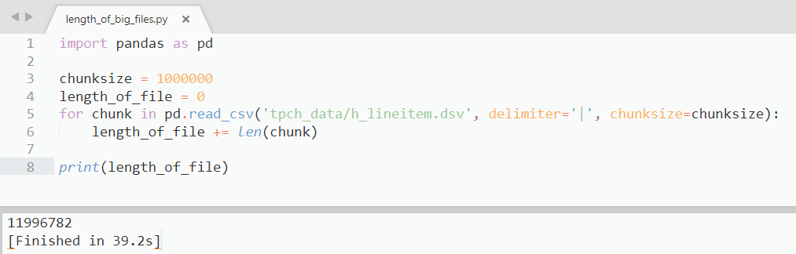


Transform to correct datatypes
Checking consistency of Azure SQL tables uploaded by counting number of rows

Slide 11
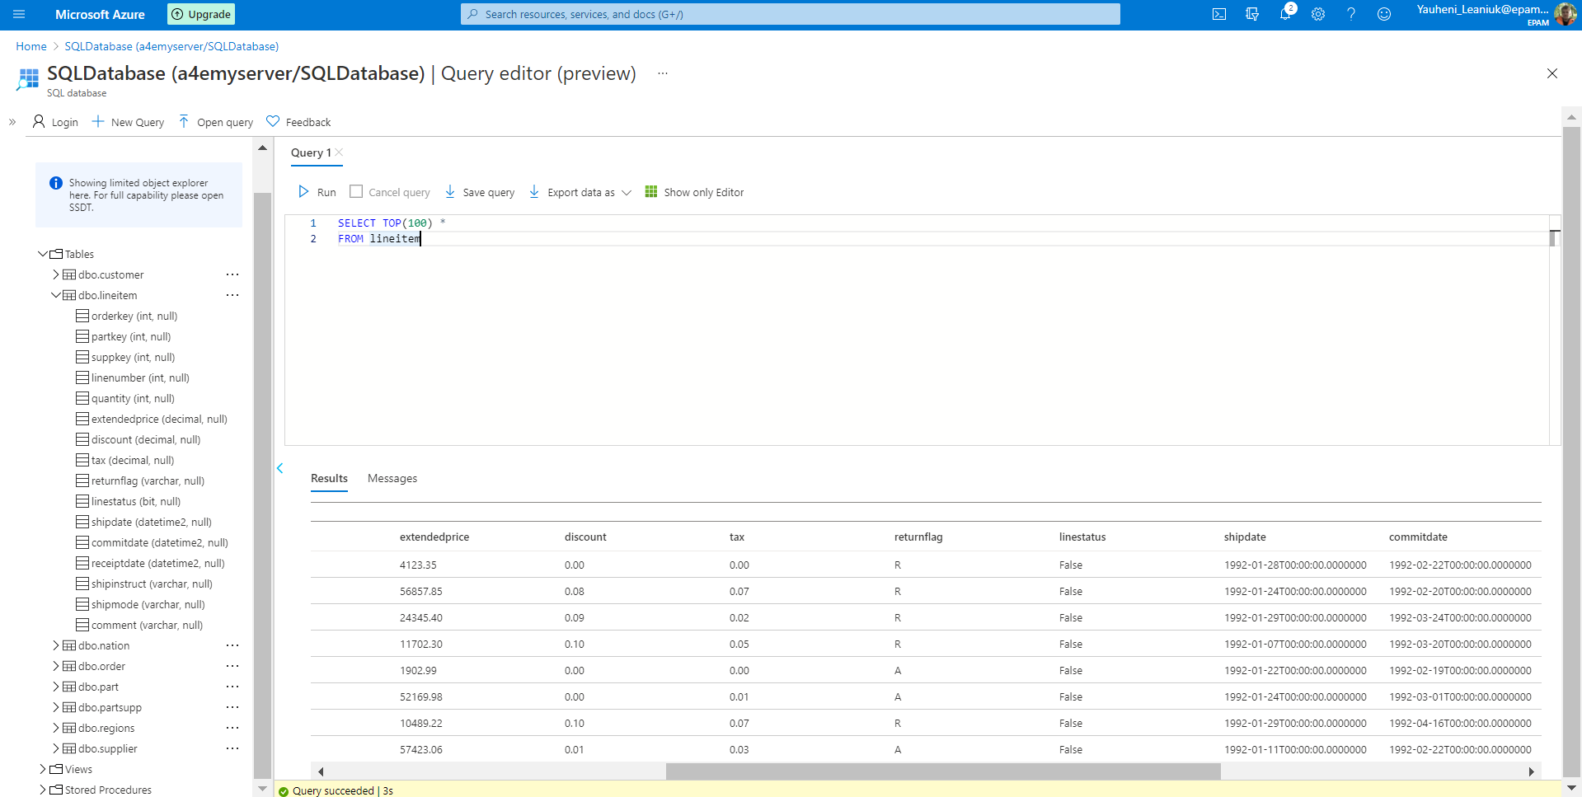
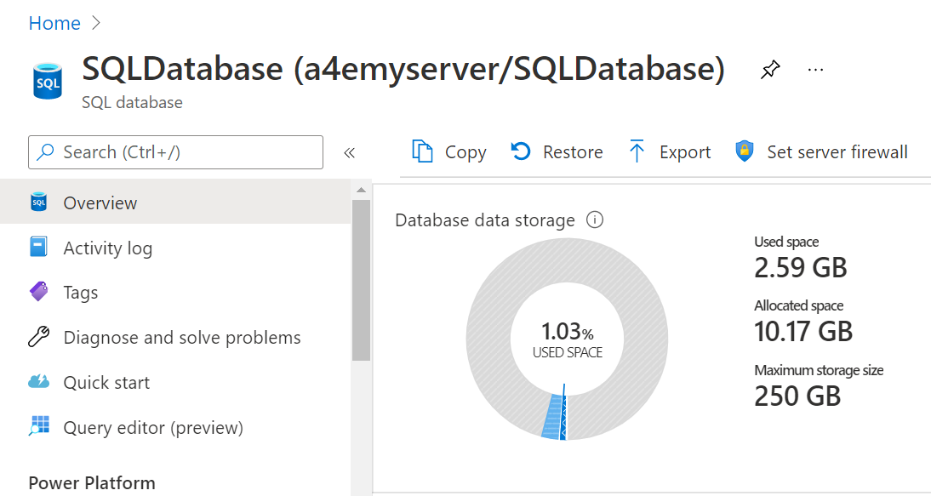
Transform to correct datatypes
Checking consistency of Azure SQL tables uploaded by checking correct datatypes

Slide 12
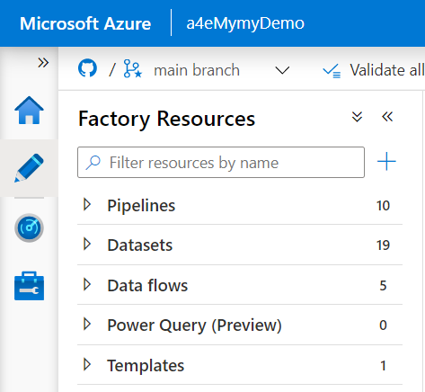
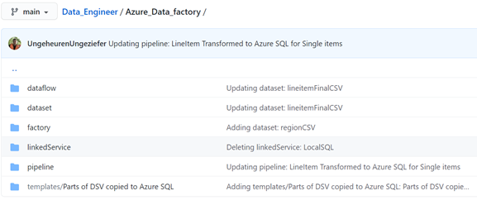
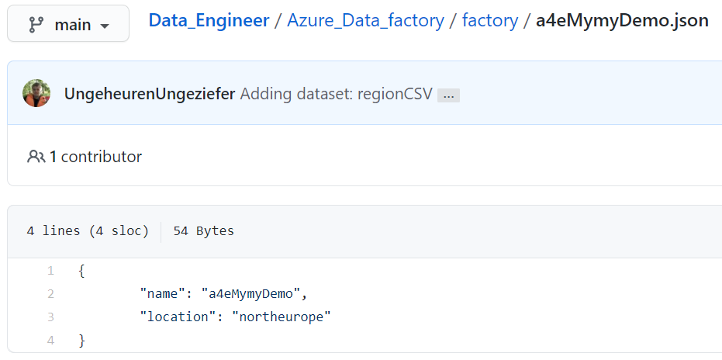
Azure Data Factory integration with GitHub
All generated code uploading into github in JSON format while saving pipeline or dataflow

Slide 13
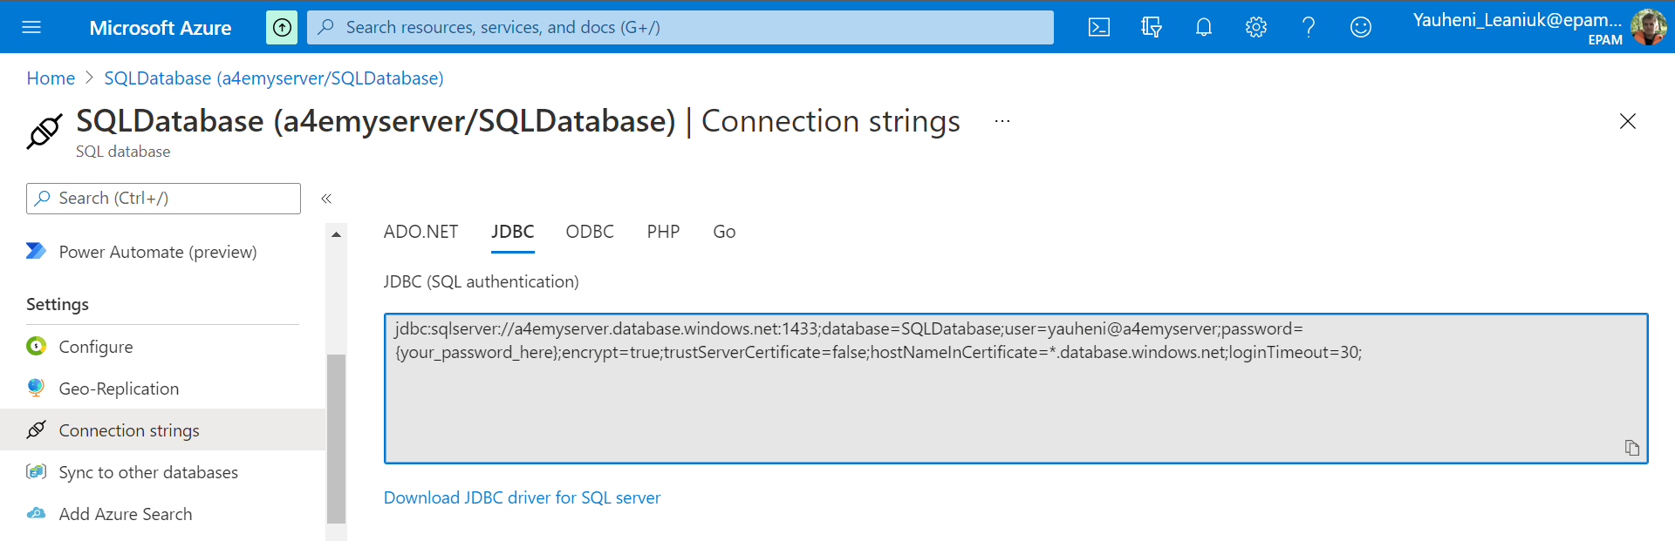
Connect PowerBI to Azure SQL DB
Using connection string JDBC
Copy servername and username to PowerBI

Slide 14
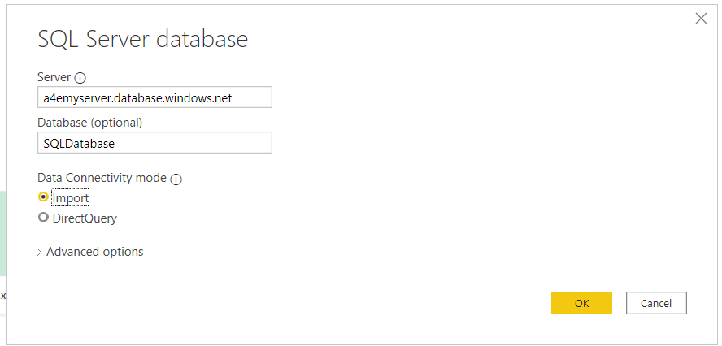
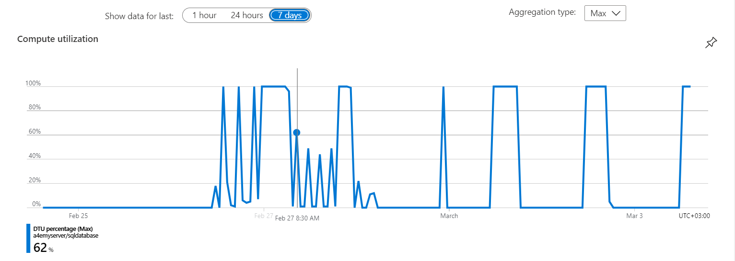
Connect PowerBI to Azure SQL DB
Paste info and logging in Azure SQL
Data uploading
Working with PowerBI

Slide 15
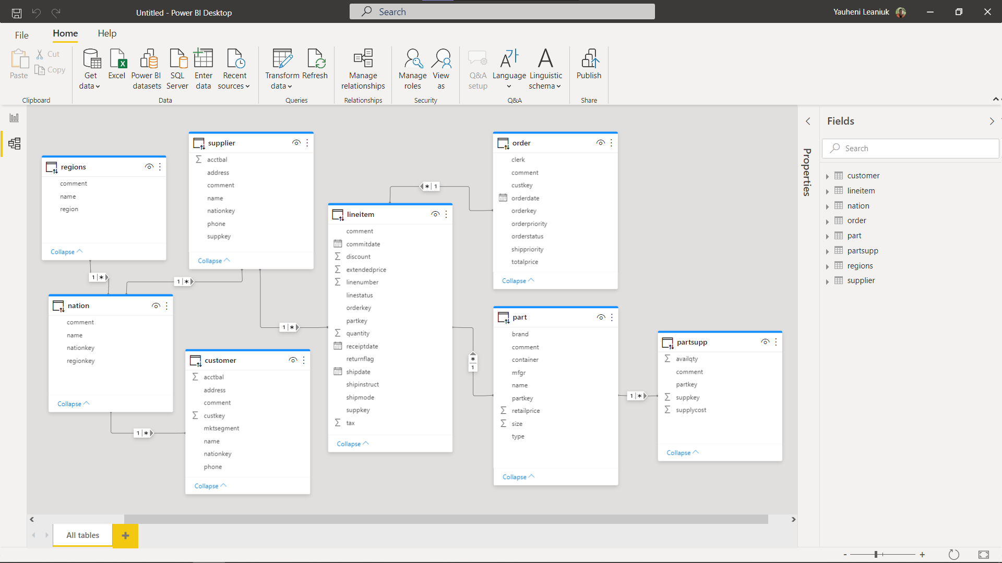
Connect PowerBI to Azure SQL DB
Creating keys and schema

Slide 16
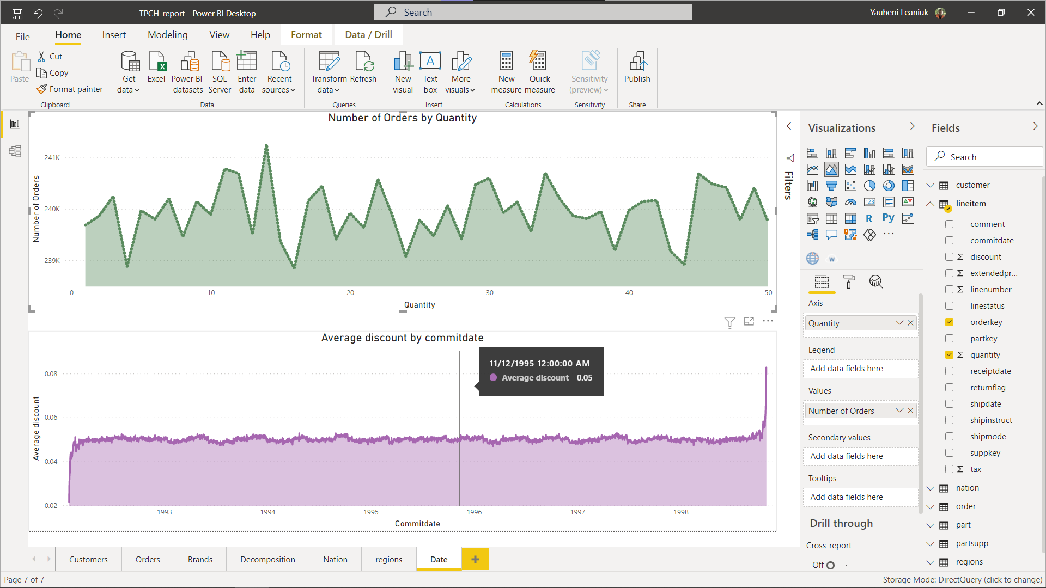
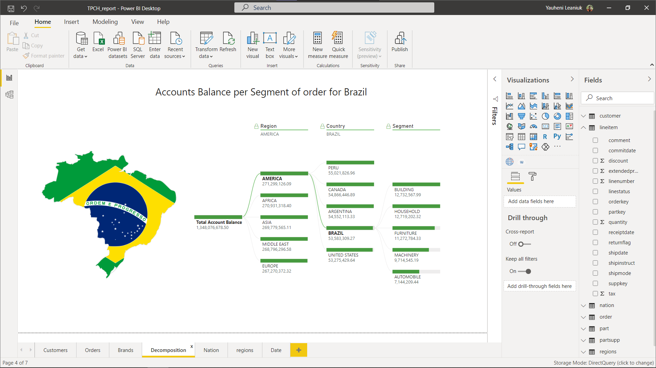
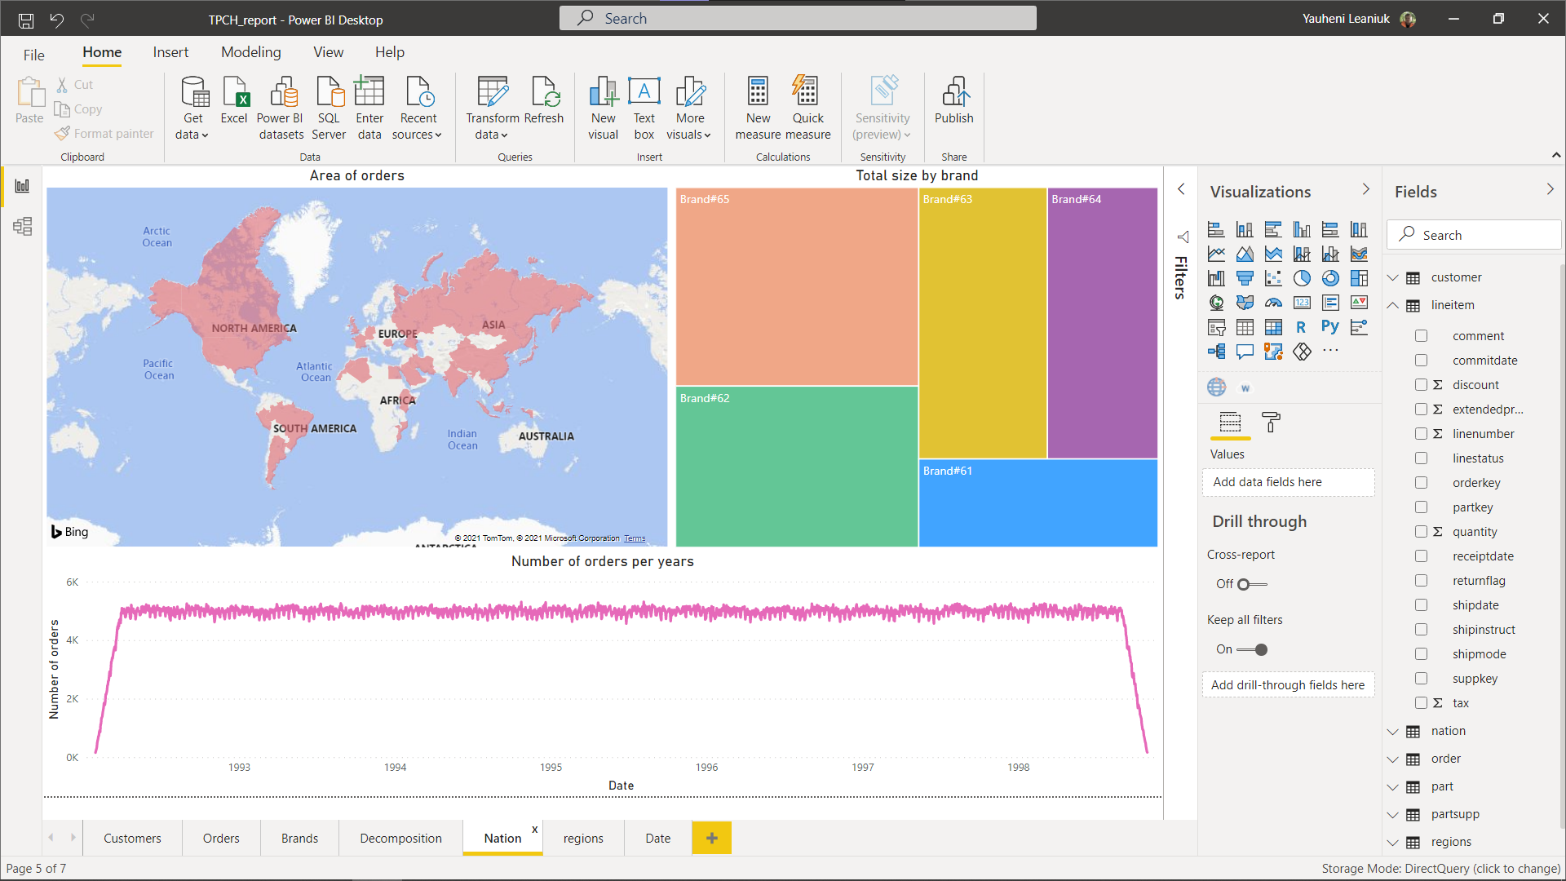
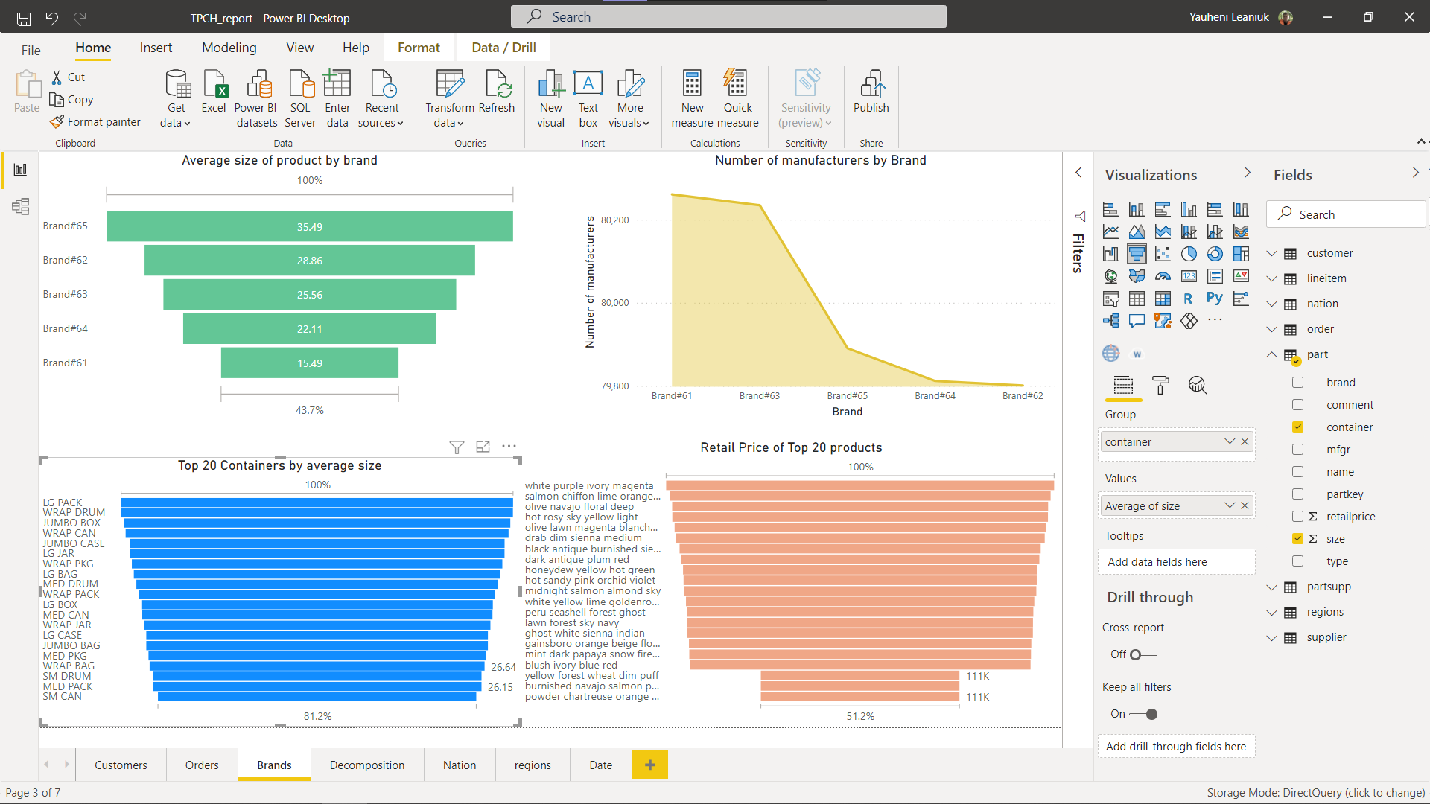
Connect PowerBI to Azure SQL DB
Creating Report and dashboards

